Slide 1
What’s the latest in psychiatric genetics and how can we use it?
James J. Crowley, PhD
Assistant Professor
UNC Chapel Hill: Genetics & Psychiatry
Karolinska Institutet: Clinical Neuroscience
12 January 2017
Rück lab retreat

Slide 2
Outline
Essential background
Scandinavian biobanks make big difference
Genetic overlap across psych disorders
Pharma interested in psych again
Some clinical relevance – at last
“Extreme” phenotypes
GxE

Slide 3
Essential background

Slide 4
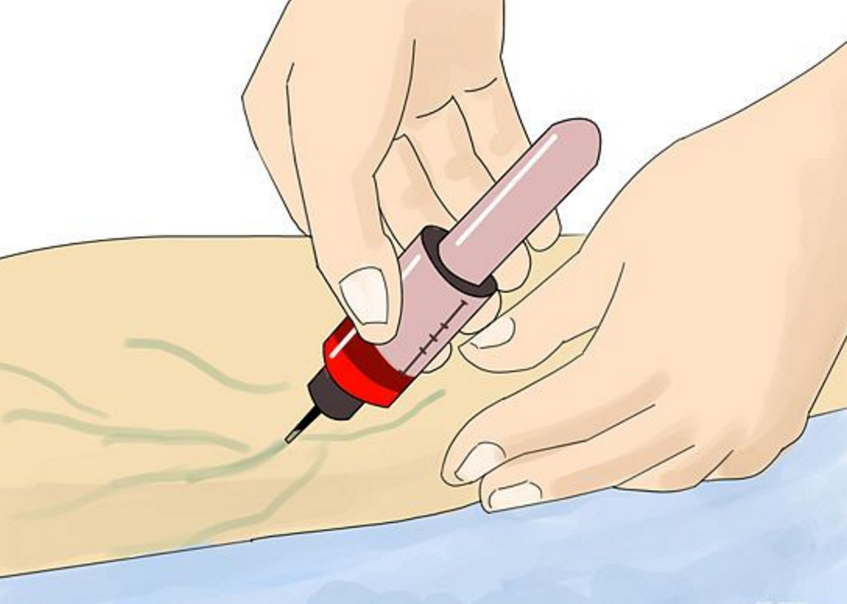

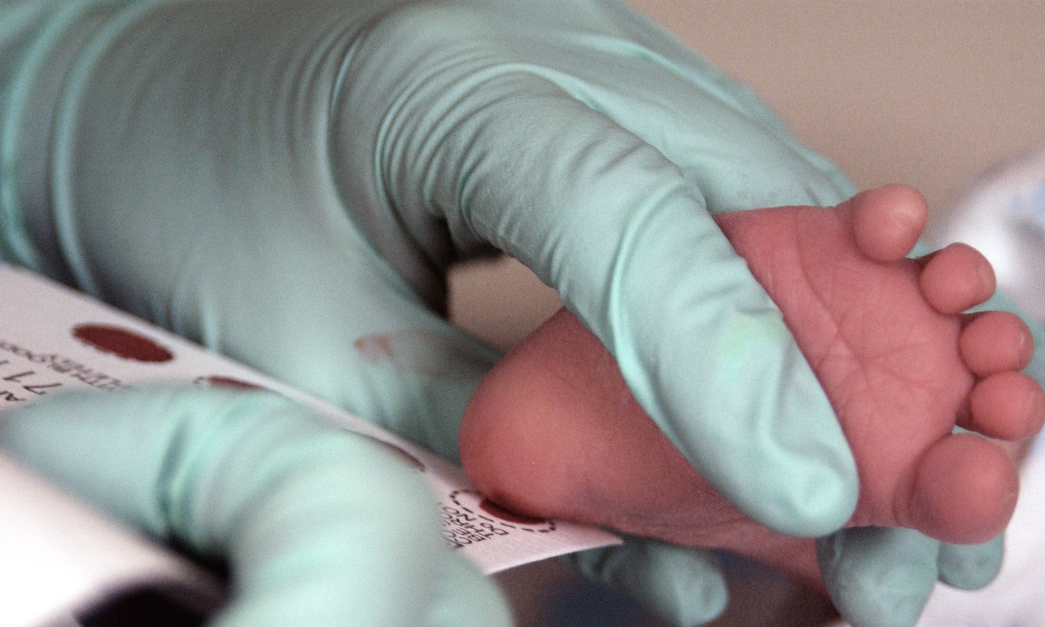
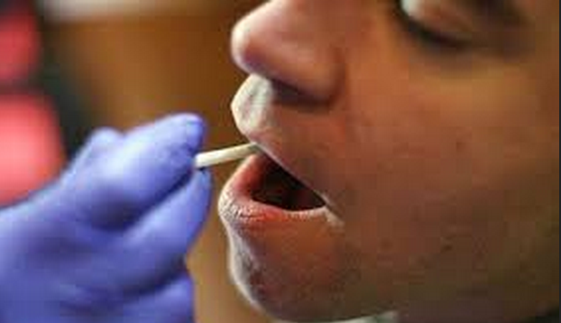
DNA: sources

Slide 5
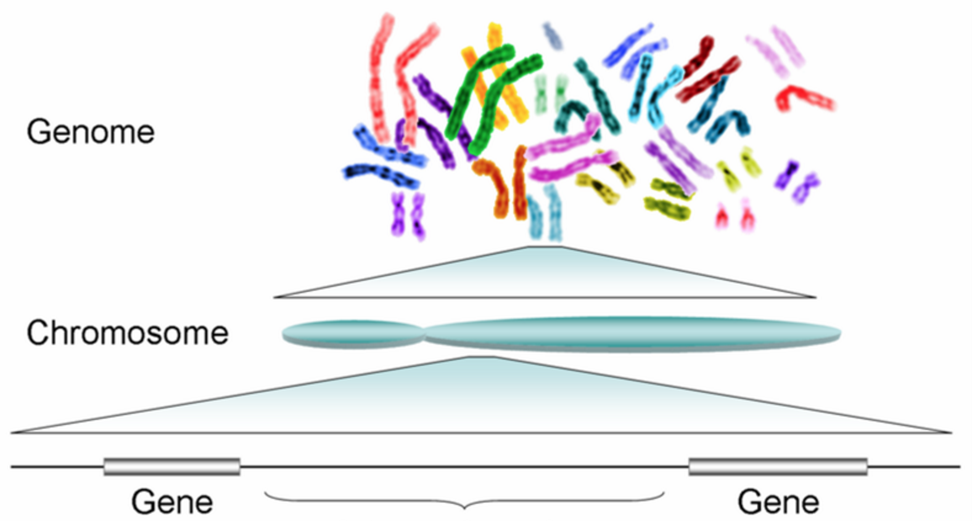
DNA: terminology
Genome
3 billion letters
(A, T, G, C)
Chromosome
23 pairs
Gene
~20,000 genes
Variation
~ 3 million SNPs
Exon
Intron
Single nucleotide polymorphism (SNP)

Slide 6
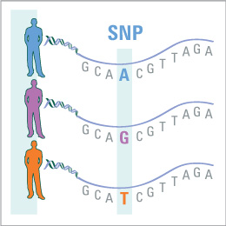

Single nucleotide polymorphism (SNP)

Slide 7
DNA: analysis methods
Method | Data | Pros for psych dx | Cost/sample
GWAS | Genotype ~1M SNPs spread across genome | Cheap, fruitful, easy to meta-analyze | $40
Candidate gene | Sequence handful of genes with a priori info | None | $100
Exome sequence | Sequence protein-coding region of all genes | Detects rare variants, which could be at play | $300
Genome sequence | Sequence entire genome | Detects everything | $1,200

Slide 8
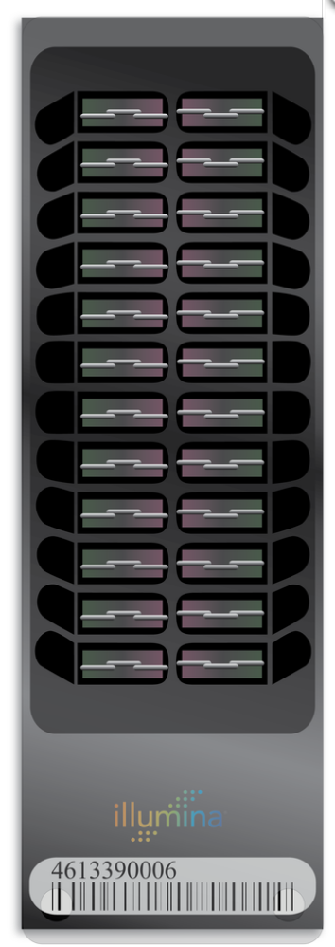
Background: DNA genotyping
  a collection of microscopic DNA spots (“probes”) attached to solid surface
  for each SNP, two “probes” present
  ~1M SNPs/microarray
  can only detect known variation

Slide 9
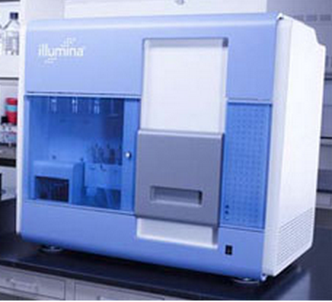
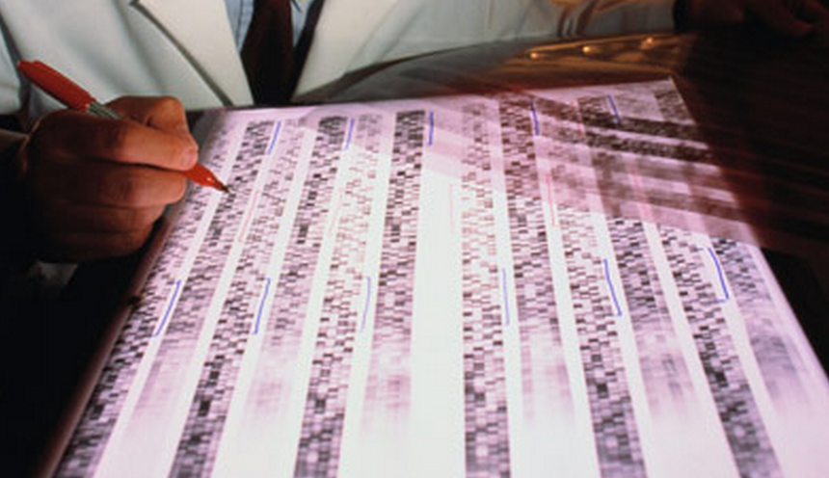
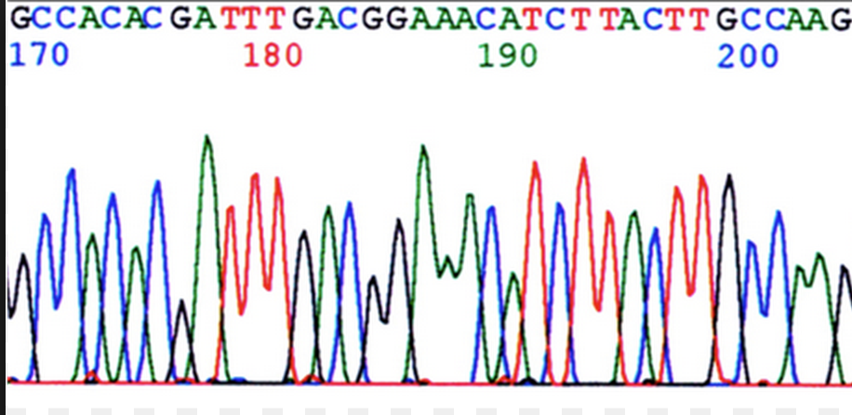
Background: DNA sequencing
can detect all types of variation, regardless of prior knowledge
1980’s
1990’s
2000’s

Slide 10
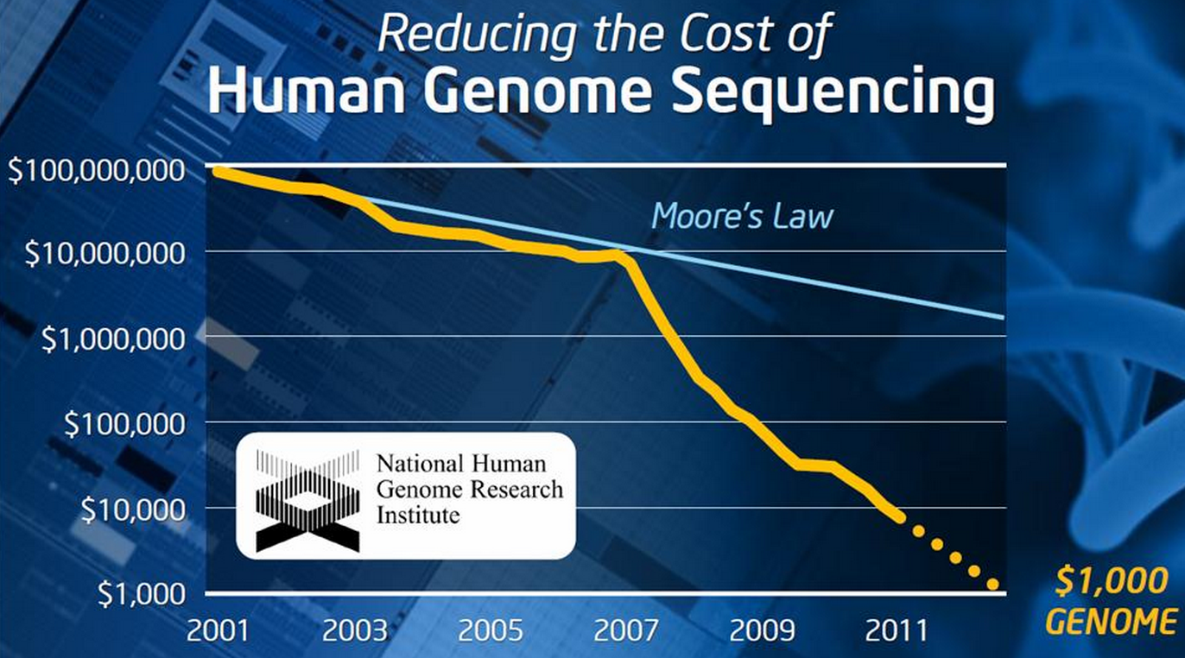
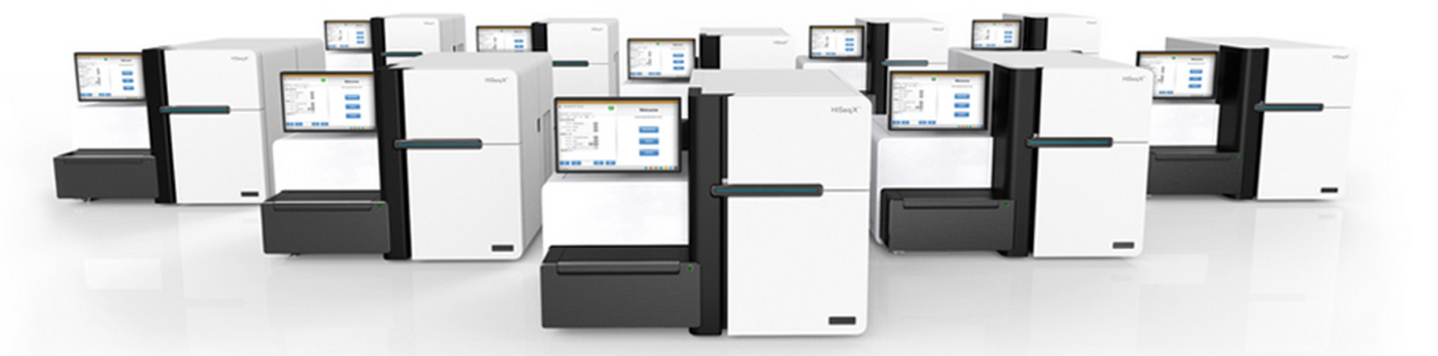

Slide 11
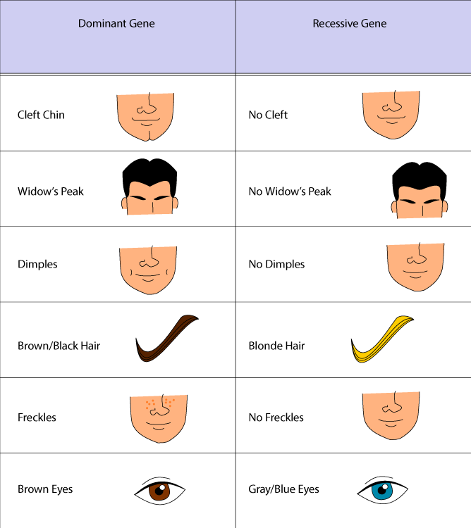
Inheritance – simple traits

Slide 12
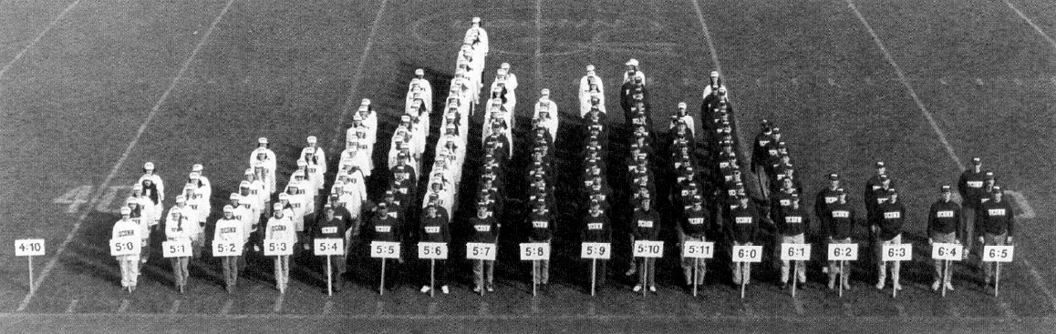
Inheritance – complex traits
Few “tall” gene alleles
Many “tall” gene alleles

Slide 13
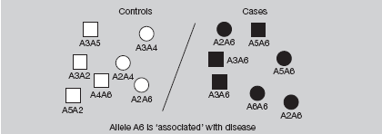
Association
look for relationship between cases and control (thousands each) and genetic markers (millions)

Slide 14
SNP genotyping microarrays
  a collection of microscopic DNA spots (“probes”) attached to solid surface
  for each SNP, two “probes” present
  ~1M SNPs/microarray

Slide 15
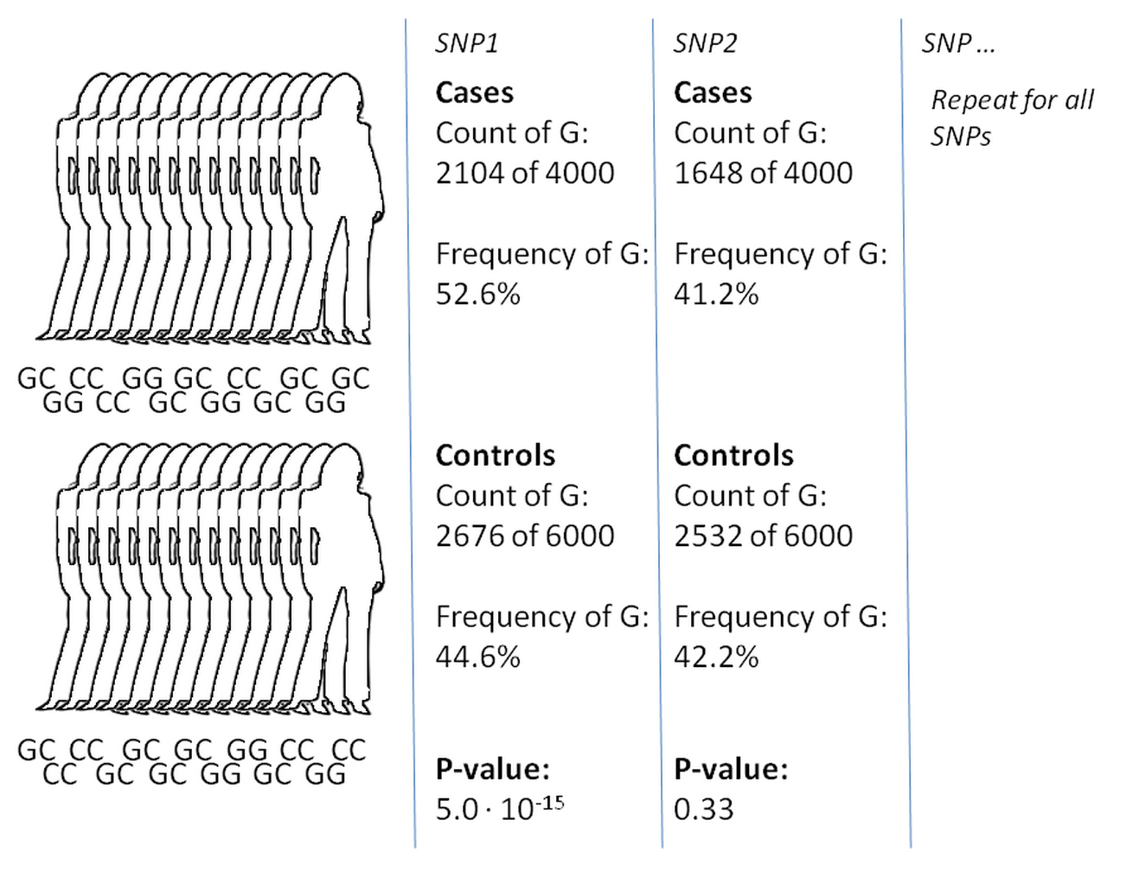
Genome-wide association study (GWAS)

Slide 16
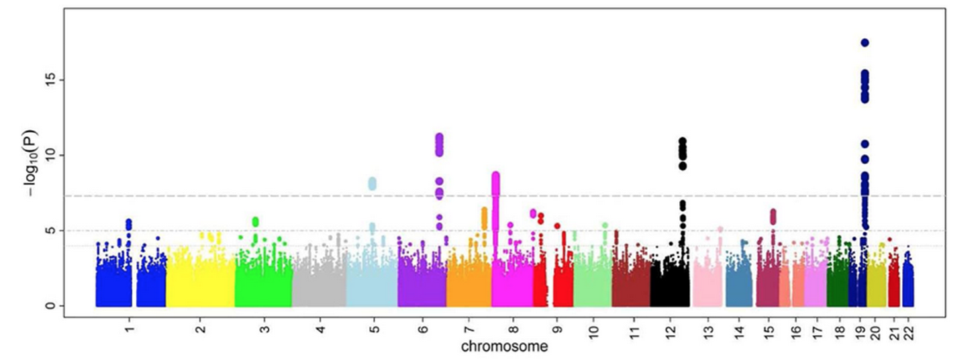
Genome-wide association study (GWAS)

Slide 17
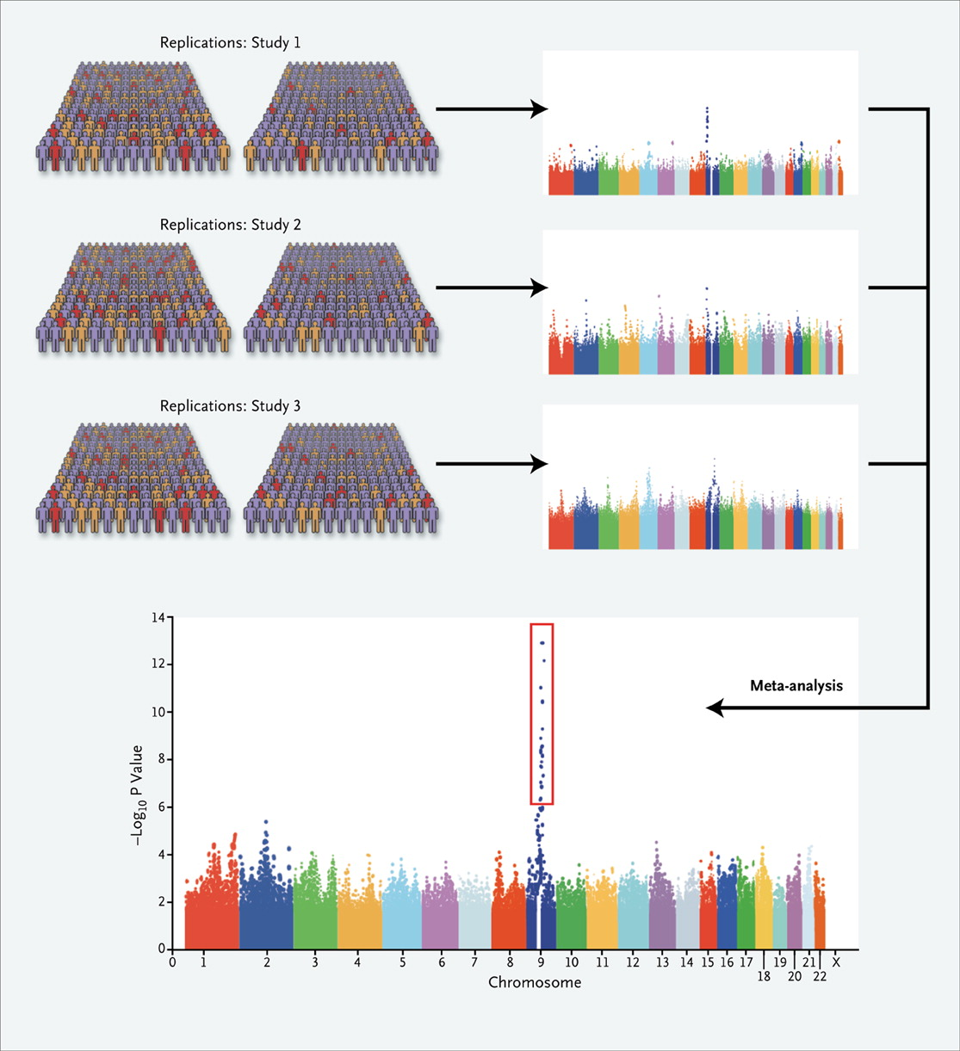
GWAS: meta-analysis

Slide 18
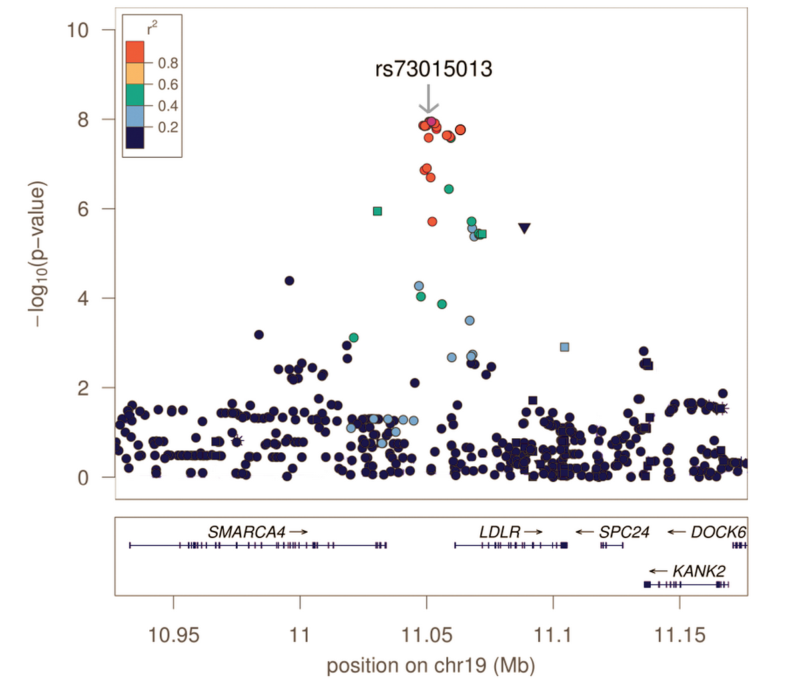
GWAS: “hit”

Slide 19
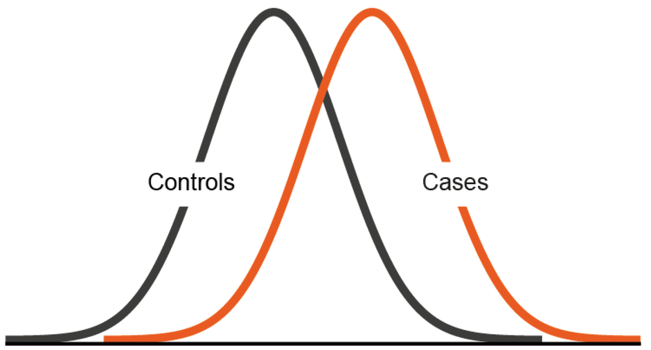
SNP risk profile score
Simply the total number of schizophrenia risk SNP genotypes in your genome
Controls
Cases
Risk profile score

Slide 20
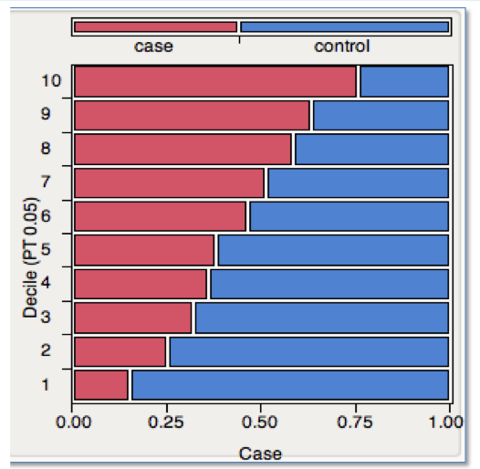
Clinical utility? ….getting there…
Risk profile score

Slide 21
Lessons learned
Large samples key
High polygenicity & pleiotropy
GWAS & Exome seq revealing pathways
Whole genome sequencing beginning
Future challenges:
  phenotypic heterogeneity
  translating to mechanism & clinical relevance

Slide 22
Questions?

Slide 23
Scandinavian biobanks make big difference

Slide 24
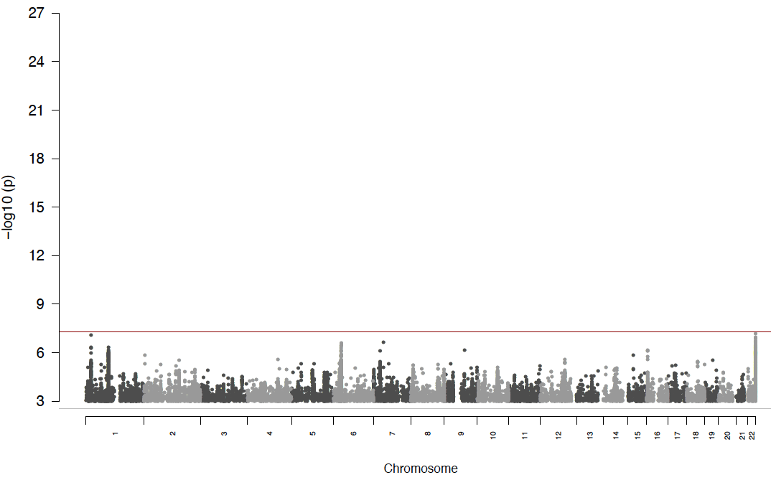
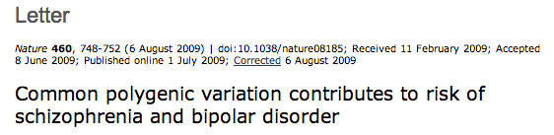
Schizophrenia GWAS: 2009
q
Cases: 2,601
Controls: 3,345
Hits: 0

Slide 25
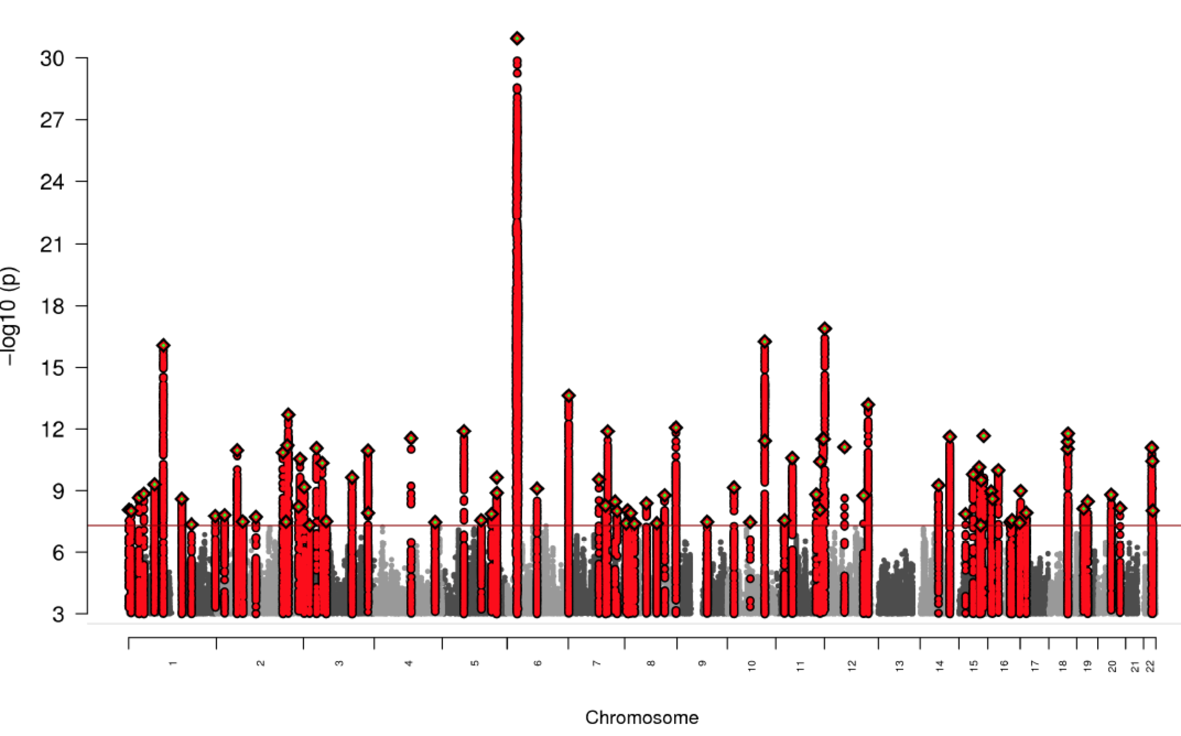
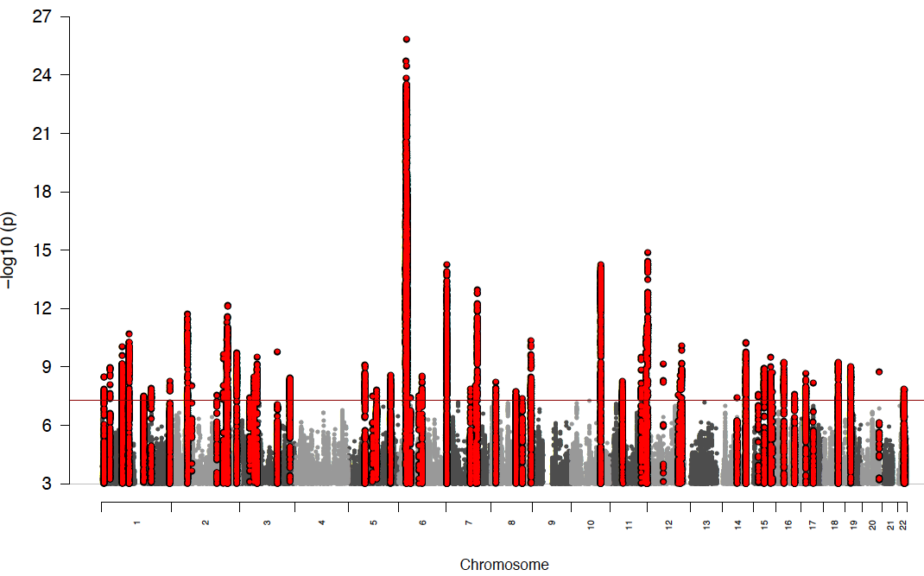
Schizophrenia GWAS: 2014
Cases: 35,476
Controls: 46,839
Hits: 108
Biological insights from 108 schizophrenia-associated loci. Nature 511, 421-427 (2014)

Slide 26
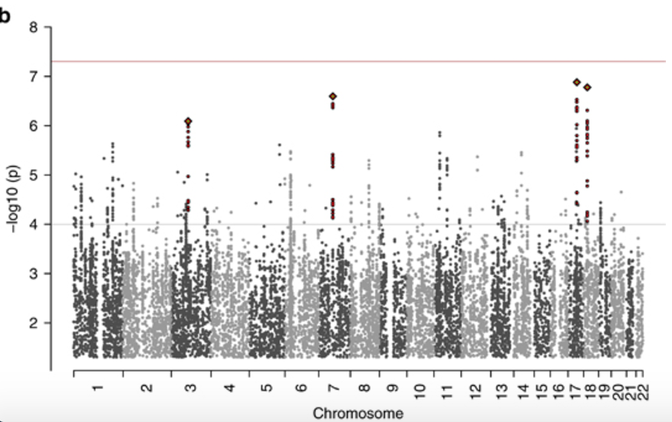
ADHD GWAS: 2015

Slide 27
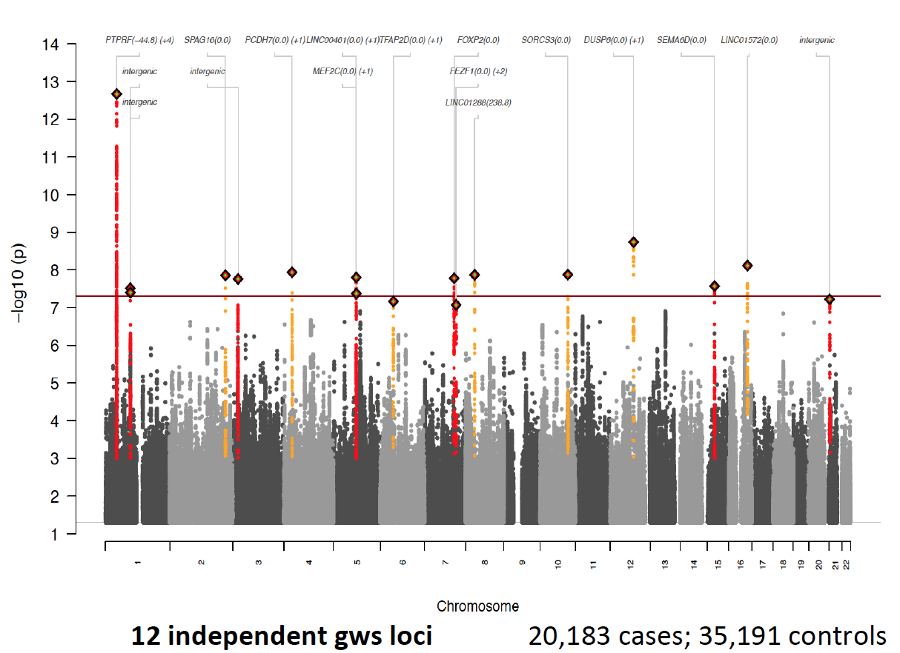
ADHD GWAS: 2017

Slide 28
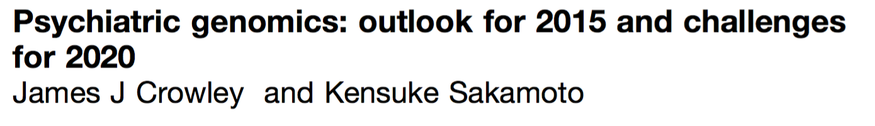
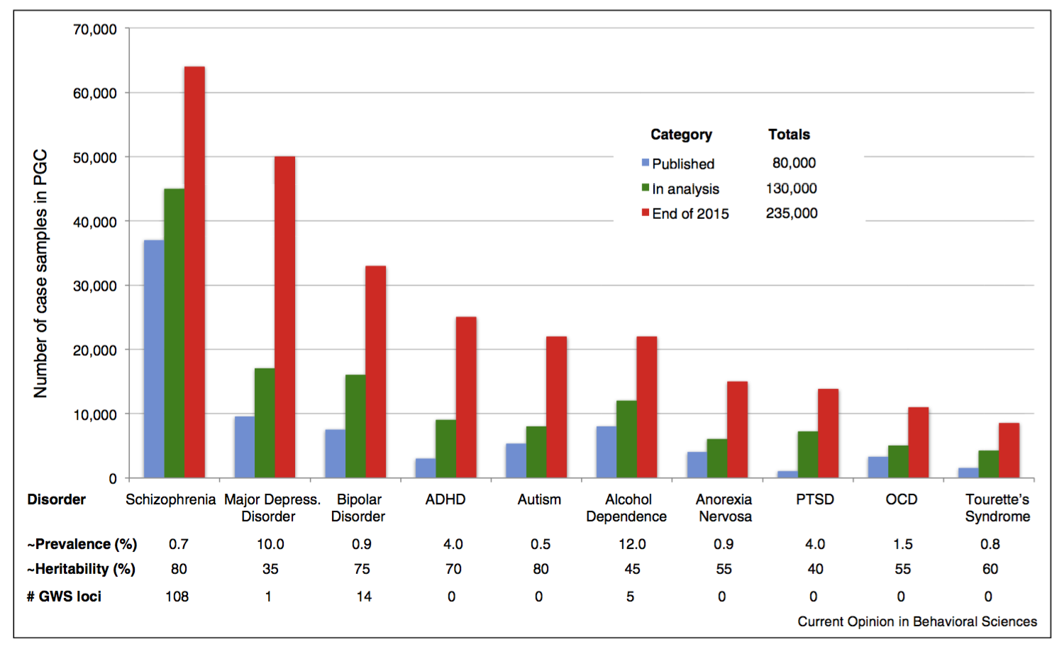

Slide 29
Questions?

Slide 30
Genetic overlap across psych disorders

Slide 31
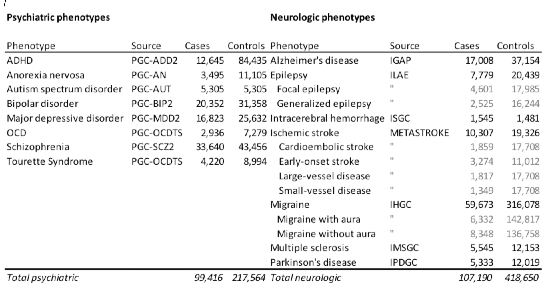
“Brainstorm” project

Slide 32
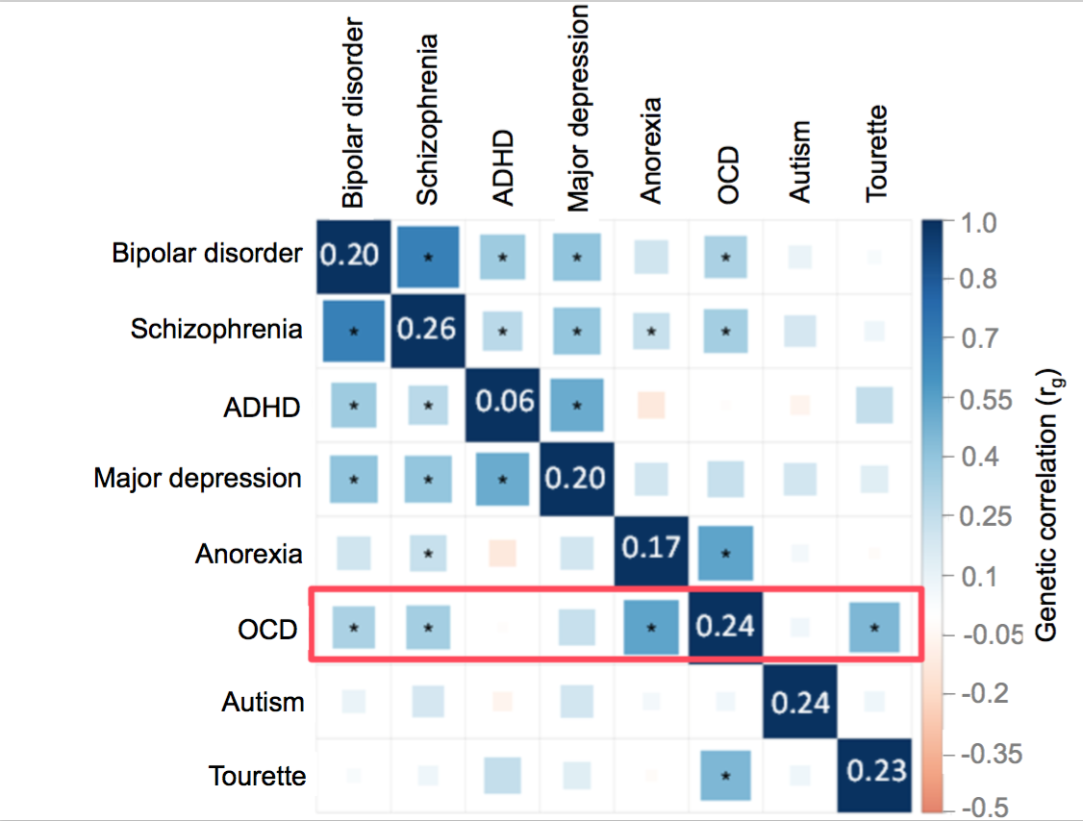
Genetic correlations across psych

Slide 33
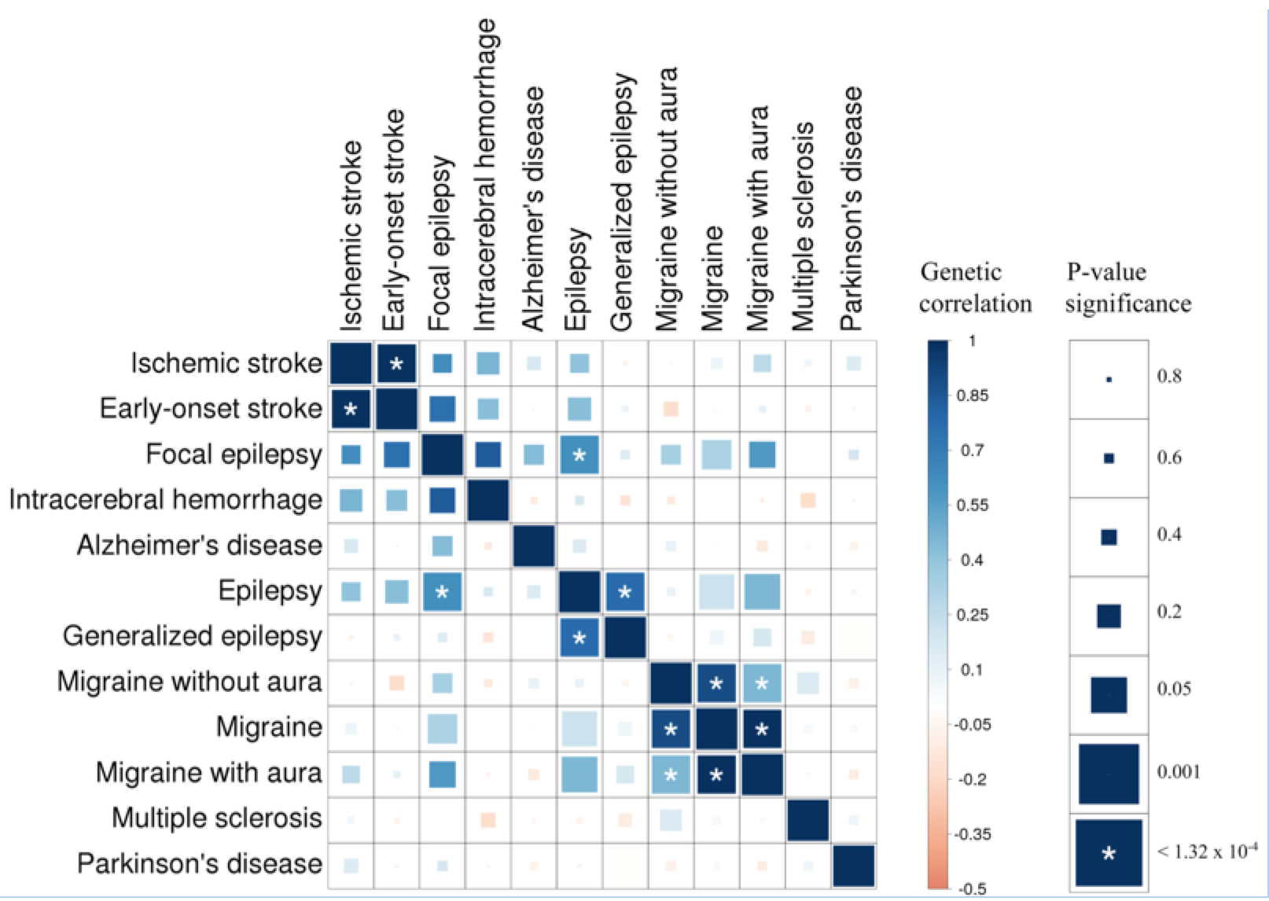
Genetic correlations across neuro

Slide 34
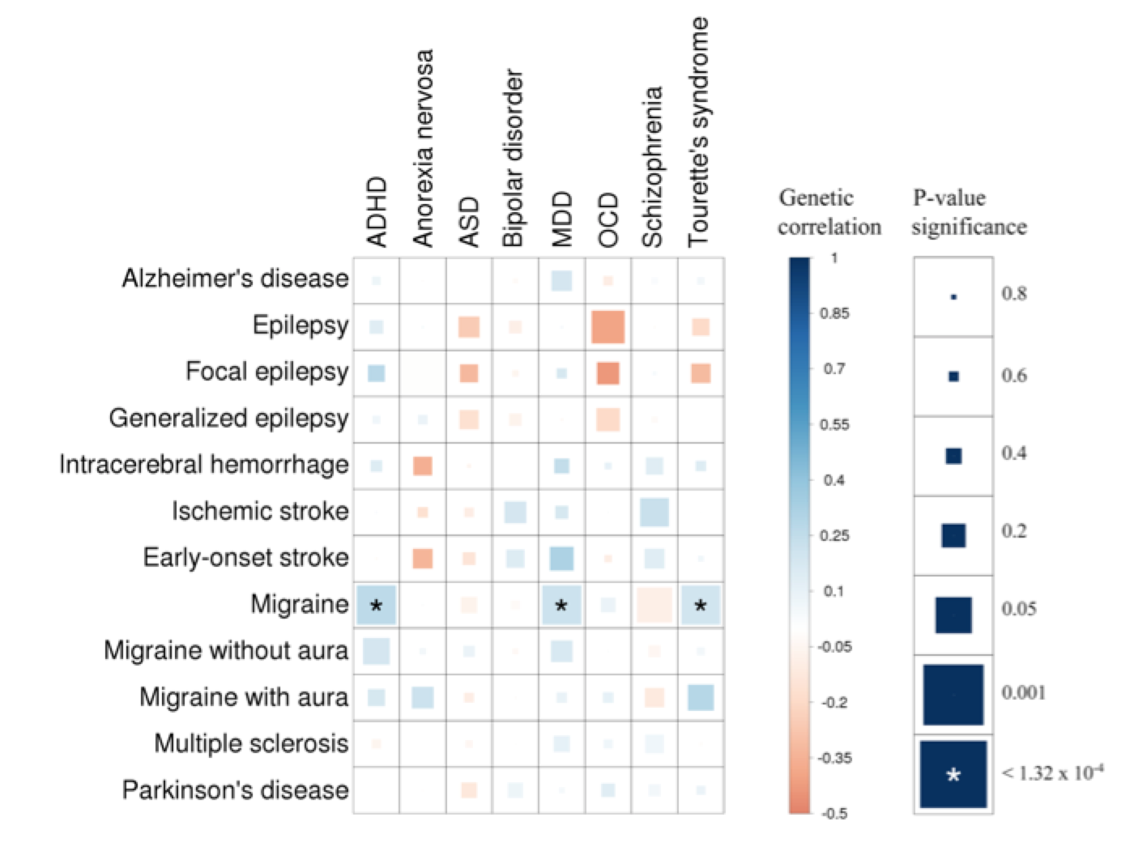
Psych:neuro correlations

Slide 35
Pharma interested in psych again

Slide 36


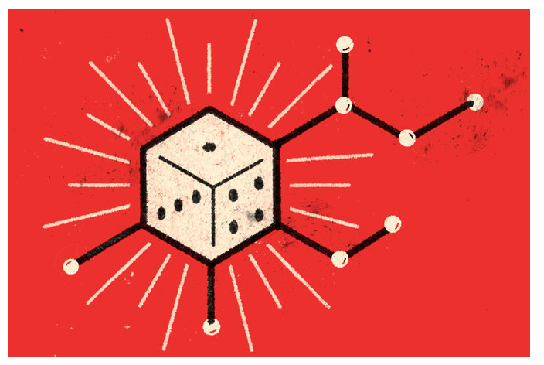

Slide 37
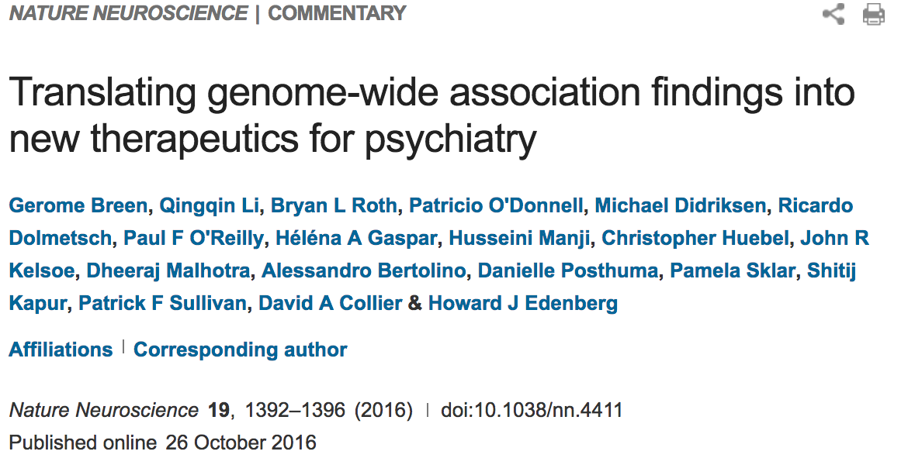

Slide 38
Some clinical utility – at last

Slide 39
Examples
Old:
Fragile X syndrome, Down syndrome, Rett syndrome, sex chromosome aneuploidy etc…
New:
Mutations (e.g. CNVs) associated with autism, schizophrenia etc are helping to define new syndromes with treatment implications

Slide 40
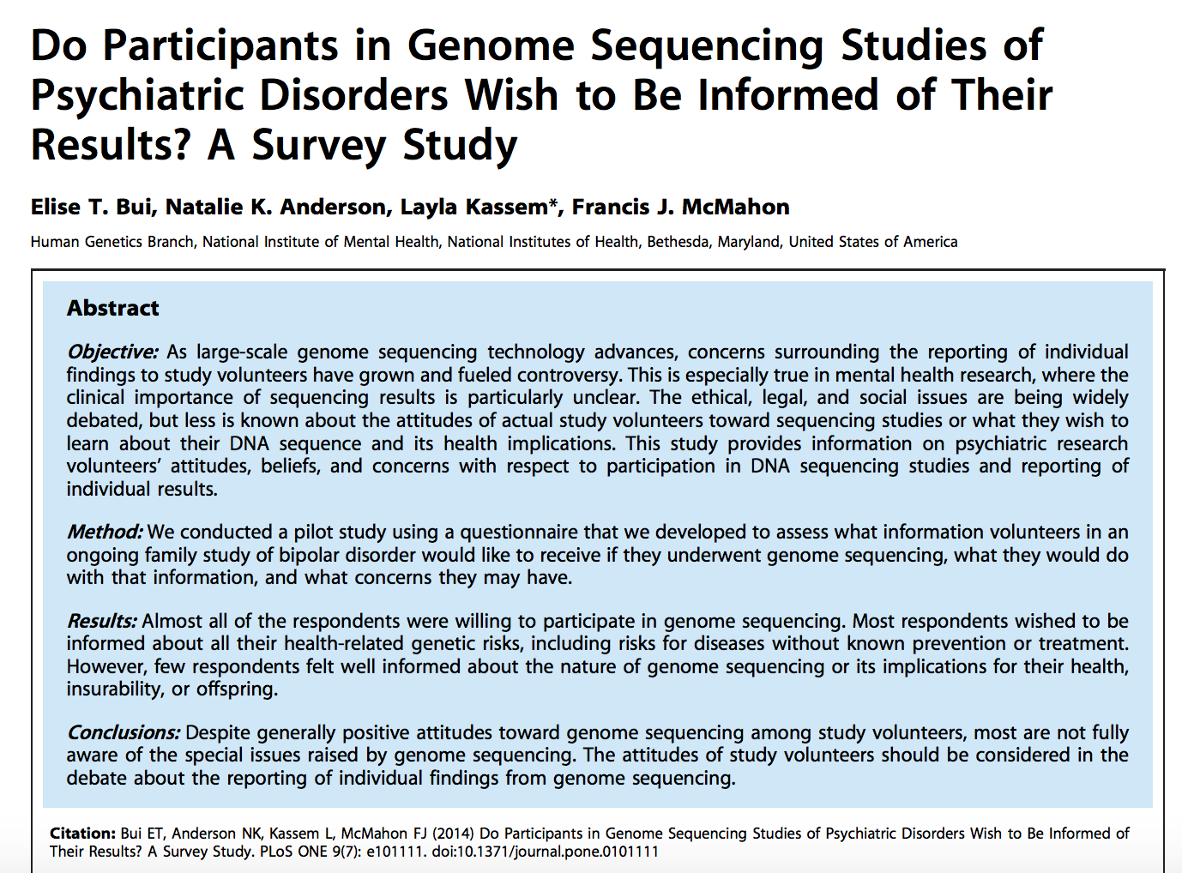

Slide 41
Extreme phenotypes

Slide 43
THANKS

