Slide 1
Grant writing workshop
13 January 2017
Rück lab retreat

Slide 2
Outline
Christian & Jim – top ten tips
Everyone:
  Think about a project that you will or could apply for and then let’s have a group discussion

Slide 3
Top ten tips

Slide 4
1. Apply for something you’re passionate about
seems obvious, but many factors could lead you to apply for something you’re not that interested in

Slide 5
2. Plan early
usually months to a year ahead of deadline
brainstorm ideas with colleagues (as we’ll do today)
verify eligibility!

Slide 6
3. Get administrative stuff out of way
Every grant requires a lot of paperwork, agreements, budgets, etc
I tend to finish this first so I can focus on the science

Slide 7
4. Assume the reviewer is not an expert
Came as a surprise to me
explain everything

Slide 8
5. Respond to what call asks for
This is what reviewers are tasked to determine – does your proposal align with call?
You can even quote call to show exactly how you are aligned with it

Slide 9
6. Start small: aims and budget
Get feedback early
Start with outlines, not fully developed text
Can save a lot of time by avoiding total re-writes

Slide 10
7. Write daily
A couple paragraphs a day adds up quickly
Prevents rushed thinking

Slide 11
8. Help reviewer “get” big picture
nobody likes to be confused
if reviewer is confused on page one, they will lose interest
include a (color) figure early summarizing the entire grant. Reviewer can refer back to if they get confused.

Slide 12
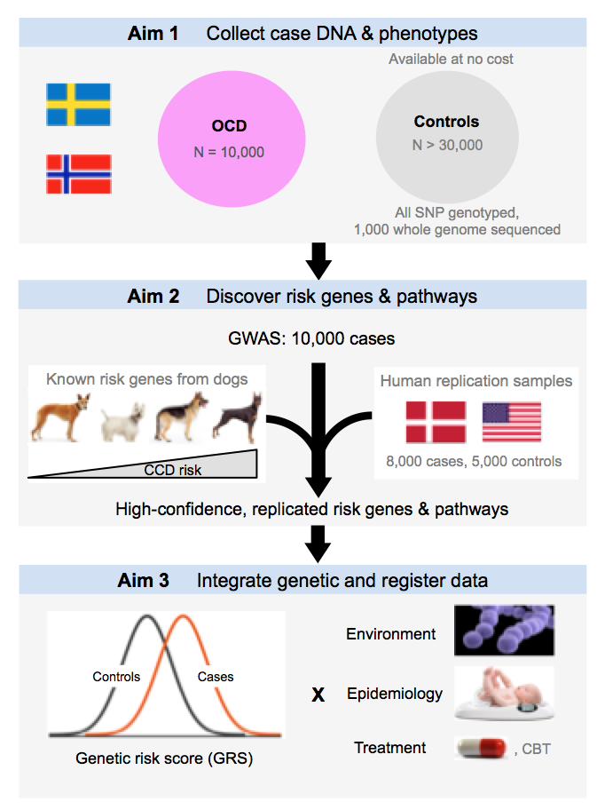

Slide 13
9. Get feedback
what isn’t clear?
where is the thinking flawed?

Slide 14
10. If turned down, keep trying
If you get a written review, read with open mind
How can you do better next time?
Persistence pays off
Where else could you send the proposal?

Slide 15
Group discussion of grant ideas

Slide 16
THANKS

